Slide 1
Repetitive Research: Who and what is it good for?
Max Korbmacher
Haukeland University Hospital
Notes:
Happy to stand here today
Thank you to all organisers and thank you for being here
Lukas set me up for this very broad talk
I will do my best to summarize what I came across the recent years
However, I might forget things or oversee important details
Please let me know! I am happy to receive feedback

Slide 2
Disclaimers & conflicts of interest
I am replicating
I am a part of the editorial team of the RR journal
No financial conflicts of interests
Notes:
We all have our biases.
For context, I would like to provide you with some of mine.
I am actively replicating and have published a replication study
I am a part of the editorial team of the upcoming Replication Research journal
Yes, I like repetitive research
No financial conflicts of interests
Stay critical ☺

Slide 3
Outline
Background
Why should we do repetitive research?
What are we talking about when saying repetitive research?
What is repetetive research good for?
Who is repetetive research good for?
Notes:
Background (historic, philosophic, and definitory) about repetitive research
What repetitive research is good for
Who is it good for?

Slide 4

Background: why repeating?
28 November 1660: the Royal Society is formed
Their motto: Nullius in verba (Take nobody’s word for it)
Notes:
The oldest scientific society in the world is the Royal Society, which was formed in 1660
Their motto, which is also the title of a nice podcast, is nullius in verba = take nobody’s word for it
Here you can already see that double checking oneself and others is an early idea in science
And how to double check:
well, repeating what has been done is a very good approach

Slide 5
Background: why repeating?
The backbones of our philosophy of science are supported by repetetive research:
Epistemic reliability (Goldman)
Notes:
We can also look at the ideas of the most influential philosophers of science of the last century.
While the tools of double checking have changed, new methods have been developed,
also the philosophy of science has evolved,
Still, the importance of checking or repeating remains unchallenged.
Let me give you some examples:
Epistemic Reliability introduced by Alvin Goldman (1979)
Refers to the degree to which scientific knowledge built on scientific methods and results can be trusted
Replications and reproductions are essential for verifying the reliability of scientific findings.
They help ensure that results are not due to chance or specific conditions of a single study

Slide 6
Background: why repeating?
The backbones of our philosophy of science are supported by repetetive research:
Epistemic reliability
Falsifiability (Popper)
Notes:
Falsifiability was proposed by Karl Popper (1934)
Findings need to be rejectable
The concept did then later inform the development of null-hypothesis testing by Fisher Neyman, and Pearson
That forms the current statistical framework
the ability to repeat experiments is a key aspect of falsifiability
Popper talked about repetition himself
but understood repetitions as not fooling oneself or validations of one’s own work
Still, falsifiability also means that if a study's results cannot be repeated, it may indicate that a theory is not robust

Slide 7
Background: why repeating?
The backbones of our philosophy of science are supported by repetetive research:
Epistemic reliability
Falsifiability (Popper)
Popper (English version: 1959; German version in 1930s) in The Logic of Scientific Discovery:
We do not take even our own observations quite seriously, or accept them as scientific observations, until we have repeated and tested them. Only by such repetitions can we convince ourselves that we are not dealing with a mere isolated ‘coincidence,' but with events which, on account of their regularity and reproducibility, are in principle inter-subjectively testable.
Notes:
We can look at this by this quote:
The Logic of Scientific Discovery from 1959:
We do not take even our own observations quite seriously, or accept them as scientific observations, until we have repeated and tested them. Only by such repetitions can we convince ourselves that we are not dealing with a mere isolated ‘coincidence,' but with events which, on account of their regularity and reproducibility, are in principle inter-subjectively testable.
- we see that repetition is of importance here

Slide 8
Background: why repeating?
The backbones of our philosophy of science are supported by repetetive research:
Epistemic reliability
Falsifiability
Paradigm shifts (Kuhn)
Notes:
Now, to conclude with the "real" scientific advances, we can look at paradigm shifts introduced by Thomas Kuhn (1962) in The Structure of Scientific Revolutions
Paradigm shifts:
Paradigm shifts involve the accumulation of anomalies that cannot be resolved within the current paradigm.
Then a change in perspective will arrive, disturbing much of the field
Replications can highlight these anomalies and contribute to theory construction and deconstruction.
Particularly in the face of ridicules findings which are very difficult to believe such as precognition, the ability of people to predict the future, double checking becomes crucial
Such ridiculous findings, following multi-lab replication attempts, both highlighting what we now call the replication crisis might be exactly what leads towards a paradigm shift

Slide 9
Background: why repeating?
The backbones of our philosophy of science are supported by repetetive research:
Epistemic reliability
Falsifiability
Paradigm shifts
More practically: Study findings are influenced by many factors beyond the true underlying effect.
Notes:
More practically that would mean that study findings are usually influenced by many different factors
Statistically: error rates i.e. true and false negative and positives
Measurement error and reliability
Validity of the study
Bias
With so many sources of error, it appears rather logical to repeat and replicate than simply believing whatever and moving on
Especially if we want to build upon the work of others, i.e. "stand on shoulders of giants" or have a "cumulative science"

Slide 10
Background: why repeating?
Why repeating? Or rather why not repeating?
Notes:
In other words, the question should not be “why repeating?” but rather “why not?”
What speaks against it?
Shouldn't it be standard practice to try to not fool ourselves as Popper would say?
Especially knowing what we know now, that not all research is 100% reproducible?
Either way ...
Whether it is your own or other’s science, the intuition would be, if it can be repeated, we can trust it more.

Slide 11
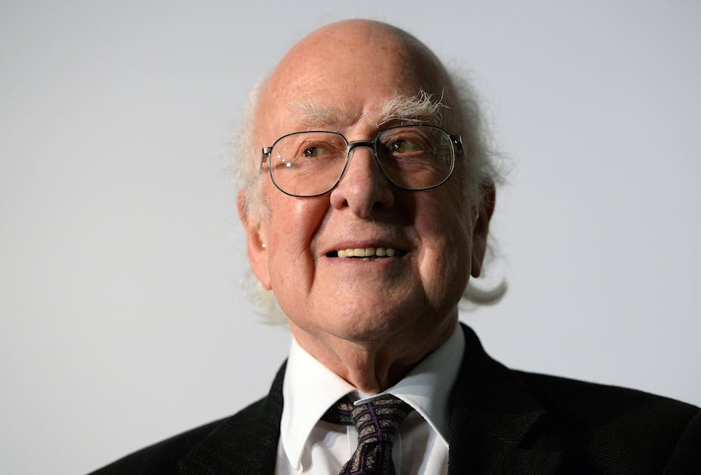
Background: why repeating?
p<0.00000029
Peter Higgs (source: Andy Rain/EPA Images)
Notes:
In some fields, it is however very difficult or expensive and thereby not feasible to repeat experiments
For example, in particle physics, and you see down here Peter Higgs, known for the Higgs Boson, the standards for calling something a true positive are stricter.
The alpha level is much lower. Just to be sure.
In other fields, it is easy to repeat studies, and the alpha level is set at a conventional 0.05.
And in many subfields physics and mathematics, findings are only accepted when being repeated.

Slide 12
“Repetition is not redundancy”
A quote from many people (among others, my office co-inhabitant)
Notes:
On that note I want to underscore that repetition is not redundancy.
Despite it being more difficult to sell repetition as something sexy, click bate-y, or the best option to sell issues, I think I made so far a point for it’s usefulness

Slide 13
Background: types of repetitive research
Reproduction: repeating research re-using data
Replication
Notes:
Before talking more about repetitive research…
Let us define what we are talking about when saying repetitive research
There are many different terms used, but I will treat them below two ubrella terms: reproductions and replications
Reproductions refer to repeating a study by using the data that are already available
For example re-analysing the data with the same or different code
One could also add additional data or change methods (possible term: reinvestigation)

Slide 14
Background: types of repetitive research
Reproduction: repeating research re-using data
Replication: repeating research by collecting new data
Direct or close replication
Conceptual replication
Notes:
Replication: sampling new data but attempting to examine the same phenomenon
One can attempt to do this as close as possible to the original finding
Or come up with a study using similar methods and examining the same or similar phenomena
The vagueness of my definitions lets you guess already that there is not necessary consensus about how to define replications

Slide 15
What is repitition good for?
Helps to …
know whether we do what we think we do. Hence, re-search.
Notes:
Now, what is repetitive research good for?
Helps to …
know whether we do what we think we do. Hence, re-search.
For example, in the wet lab, once you get a result, it has to be repeated, in order to rule out that it was due to contamination or some other error.
The same applies to most physics experiments, as I said earlier.

Slide 16
What is repitition good for?
Helps to …
know whether we do what we think we do. Hence, re-search.
check the existing knowledge.
Notes:
Helps to …
check the existing knowledge.
Do findings hold true when repeated?
Maybe also under different assumptions?
How does the prevailing theories hold up against the data?

Slide 17
What is repitition good for?
Helps to …
know whether we do what we think we do. Hence, re-search.
check the existing knowledge.
build something new.
Notes:
Helps to …
build something new.
Maybe we find cases where the theory does not hold true?
Maybe the theory therefore needs extension, rework or being thrown out all together?
Perhaps repeating lets us think twice and differently about an experiment?
We might find erros we hadn’t thought about

Slide 18
What is repitition good for?
Helps to …
know whether we do what we think we do. Hence, re-search.
check the existing knowledge.
build something new.
make better science-based decisions.
Notes:
In an age of digitalisation, we, scientists have better access to samples and can better work in big teams
Here we make crucial decisions about how we do our science, where we put our energy and money
Repetitive research can aid that process
Finally, I will argue in the following that repetitive research leads to better research
This leads to better decisions also outside academia, such as policy-making, etc.

Slide 19
“Repetition is not redundancy”
A quote from many people (among others, my office co-inhabitant)
Did I mention this earlier?
Notes:
Sometimes repetition seems banal.
But sometimes what seems banal at a first glance might come with a deeper meaning.

Slide 20
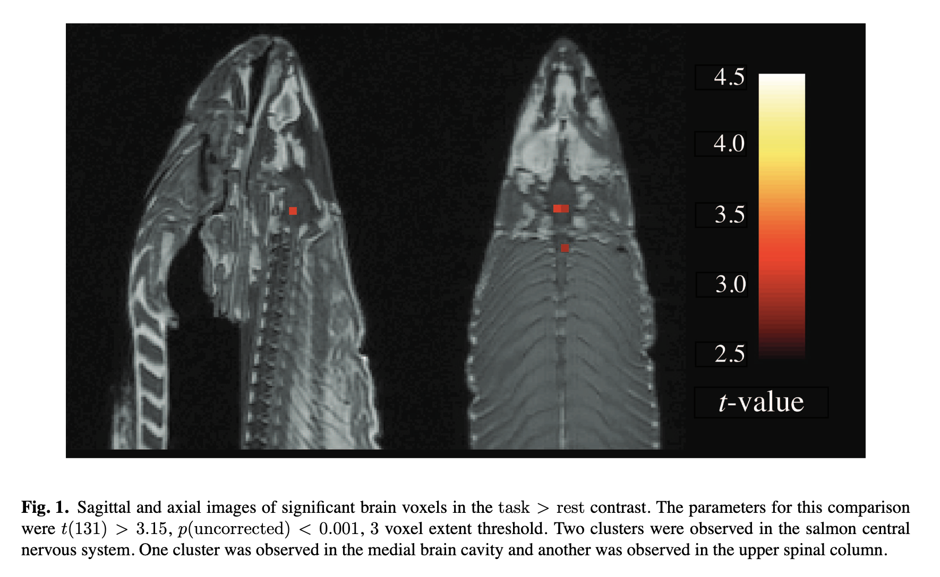
What can we learn from a dead salmon?
Bennet et al. (2009). JSUR.
Notes:
There are some truly shocking repetitions, which are at first not really looking like repetitions.
One of the most popular ones is the infamous dead salmon study
Here, a frozen salmon was put into a Magnetic Resonance Imaging or MRI scanner and taken images of
What you see in the image is a structural or T1 weighted image showing water and fat content on a grey scale and 3D pixels of significant contrasts in the red scale
Funnily, during functional MRI, one usually measures the blood-oxygen level dependent contrast, which depends on blood flow
In a frozen salmon that does obviously not make any sense, as there is zero flow of any bodily liquid
However, what the authors did was REPEAT common statistical analyses using the statistical parametric mapping (SPM) software package where at that time millions of t-test were utilized

Slide 21
What can we learn from a dead salmon?
Bennet et al. (2009). JSUR.
Notes:
The procedure led to a high level of false positives which could be interpreted as brain activity from flashing photos at the salmon asking it to complete a mentalisation task
Of course there was a pun intended ...
The paper led to much discussion and finally changes in standards in neuroimaging analyses
Historically, people did not correct for multiple comparisons
Due to crazy high false positive rates, the alpha level was at some point lowered to .001
After the paper cluster-wise thresholding and other methods were implemented, not allowing these alpha levels which led to high false positive rates
This outlines that repetitions which are seemingly redundant can be highly impactful

Slide 22
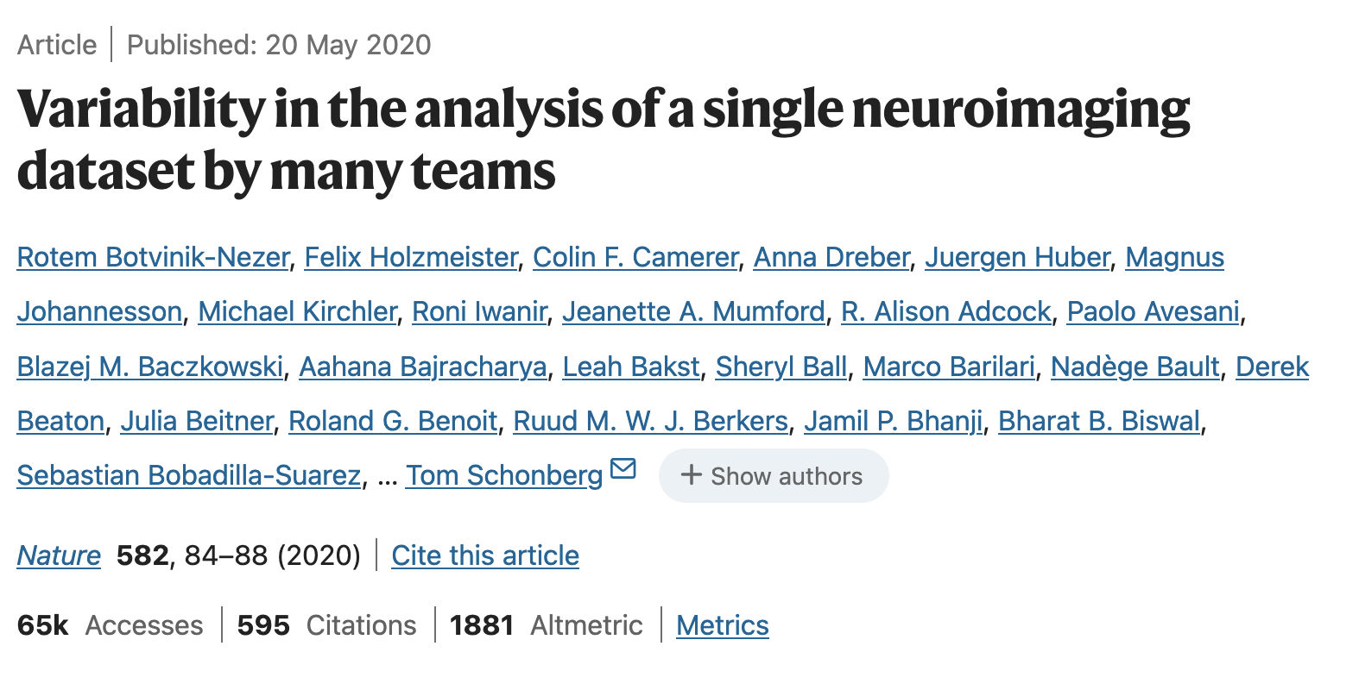
What are reproductions good for?
Testing whether different analysts come to the same conclusion
Notes:
Let’s get back to our defintions of reproductions,
Reproduction = the repetition of analyses with the same data
I will present some evidence we have from the literature and the broader context
Let’s start with multi-analyst studies as a form of reproduction.
Many analysts analyse data usually in parallel
Reproducing each other’s analyses
What they usually highlight is how analytic flexibility influences the results
For some questions, fields, types of data, the analyses are quite streamlined and results are similar. For other fields not.

Slide 23

What are reproductions good for?
Testing whether different analysts come to the same conclusion
$$$
Notes:
Taking this well-published example of neuroimaging, the pipelines are crazy complex and hardly the same between labs
Across the 70 labs, and on average across the 9 hypotheses, 20% of teams reported a result that differed from the majority of teams
That means that given the maximum possible variation of 50%, the observed fraction of 20% divergent results thus falls midway between complete consistency across teams and completely random results,
→ demonstrates that analytic choices have a major effect on reported results
$$$

Slide 24
What are reproductions good for?
Testing even broader: reanalysing 100 studies in the social and behavioural sciences
The “Many100” project: 5 analysts per hypothesis, where the selected 100 studies had many hypotheses ☺
Result:
Only 31% of the independent re-analyses yielded the same result (within a tolerance region of ± 0.05 Cohen’s d) as the original report.
With 4x broader tolerance region, this indicator did not go above 56%
For 34% of studies all analysts came to same conclusion, for 39% when >80% agreed
Notes:
Let’s take some unpublished results from the social and behavioural sciences where 100 studies published between 2009 and 2018 in criminology, demography, economics and finance, management, marketing and organisational behaviour, political science, psychology, and sociology where reanalysed
Only 31% of the independent re-analyses yielded the same result (within a tolerance region of ± 0.05 Cohen’s d) as the original report.
With 4x broader tolerance region, this indicator did not go above 56%
For 34% of studies all analysts came to same conclusion, for 39% when >80% agreed
My conclusion would be, the more possible researcher degrees of freedom, or analysis and processing choices, the more variability or noise will be invoked in the results.

Slide 25
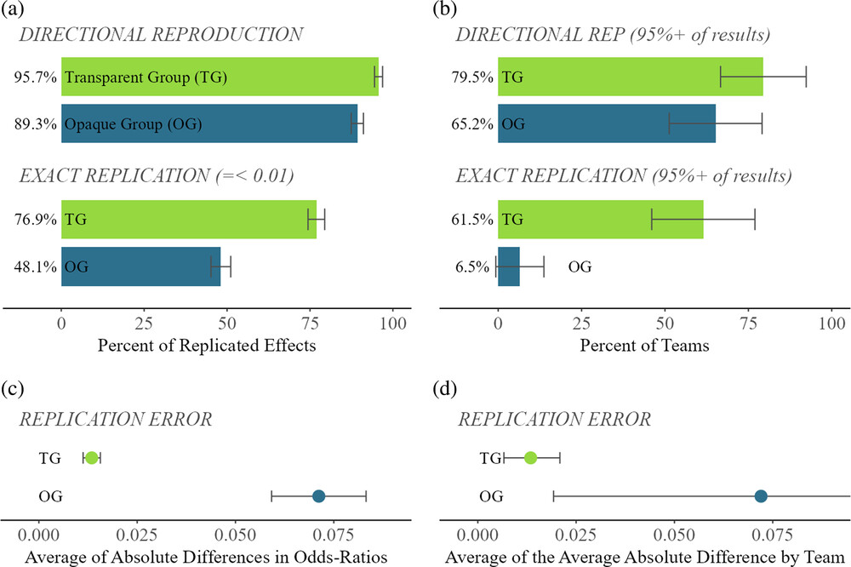
What are reproductions good for?
TG recived materials
OG did not
Breznau et al. 2025. Royal Soc. Open Sci
Notes:
Some caveats ...
When reproducing other’s findings, the openness of materials is important for the success of the reproduction
Both in terms of execution and results!
Figure
Transparent Group, TG recived materials
The opaque group, OG did not
a) top directional: reproduction
a) bottom: exact reproduction
B) THE SAME BUT Success only when 95% of a teams’s models where successful reproductions
c)-d) binary labels of success
These results are promising for political sciences, but might also have to do with how easy it was to do the reprocutions
Either way, transparency plays a role and cut offs influence the way reproductions results are represented
This last point connects to a discussion on how to interpret replication, which applies here as well
how exact should repetitions be labelled successful?
Can we even use binary categories of success?

Slide 26
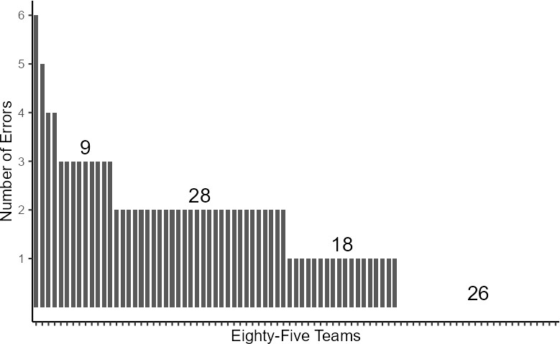
What are reproductions good for?
Breznau et al. 2025. Royal Soc. Open Sci
Notes:
A final point of the paper is that reproducers can make mistakes
One bar per reproduction team
Number of errors on y-axis
These mistakes or errors can have various sources
Point is: reproduction rates contain some level of noise / they are not 100% reflecting the true reproducibility

Slide 27
What are reproductions good for?
Another way of assessing the influence of analytic choices: Multiverse analysis
Notes:
A more computational way to assess effects in a body of literature where we are worried of publication bias, is a technique called multiverse or specification curve analysis
Publication bias refers to a misrepresentation of the direction of evidence. For example, by selectively reporting only significant findings, it might appear like there is an effect, which is however a null effect in reality, when consider the even larger number of non-significant findings
Multiverse analysis refers to a technique where many plausible analytic paths are defined and then executed which translates to estimating many models and their coefficients
You can imagine that the blocks here are out variables and the different ways of combining them to build a tower represent the different analytic choices a researcher can make
By estimating many effects, they can then be assessed in terms of their variability, etc.

Slide 28
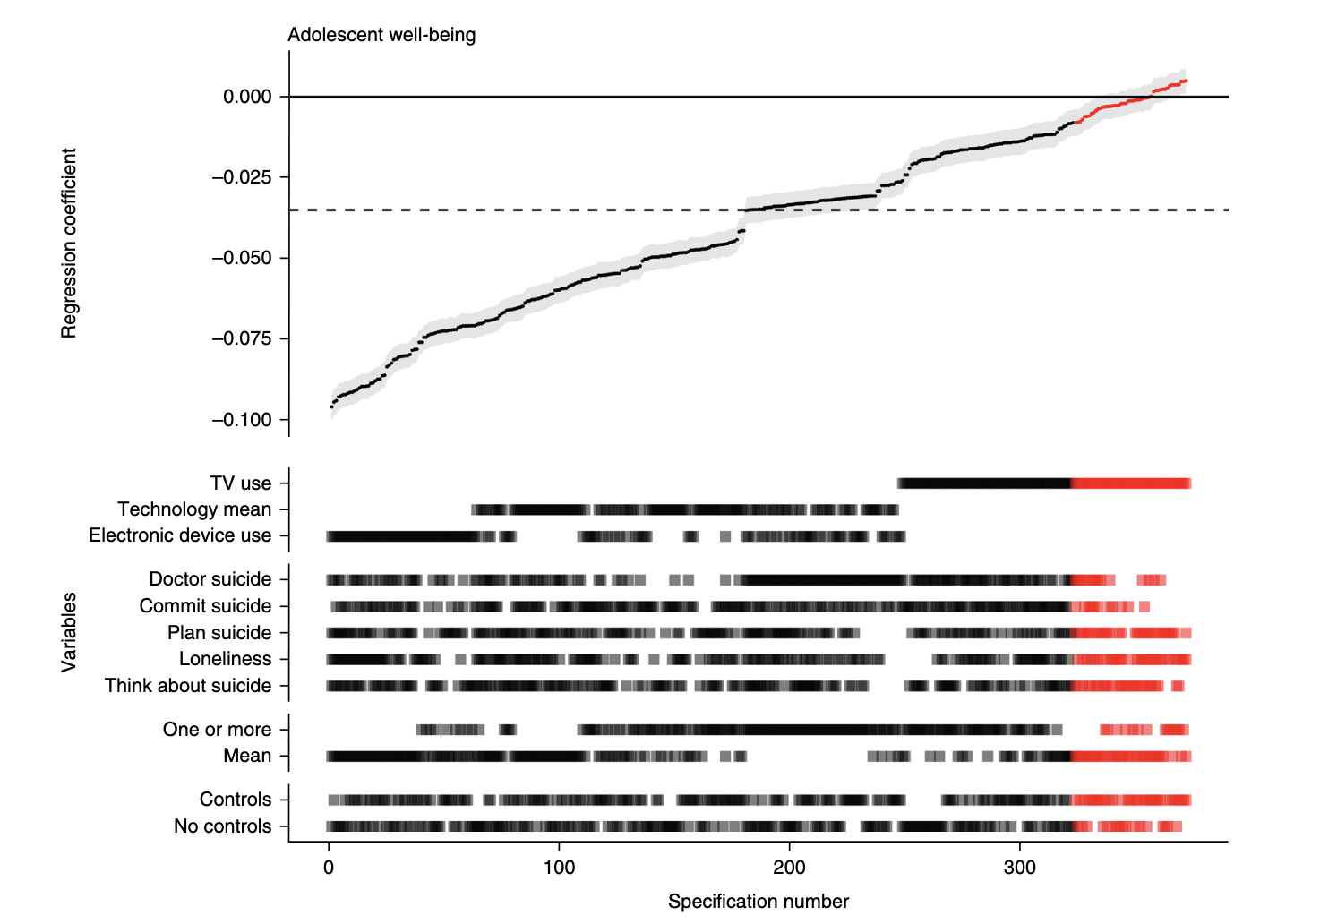
median standardized regression coefficient = -0.035 social media use on well-being
Specification curve analysis showing the range of possible results for a simple cross-sectional regression of digital technology use on adolescent well-being. Orban & Przybylski (2019). Nat. Hum Beh.
Notes:
For example, Orban and Przybylski (spoken: shibilsky) wanted to look at the influence of digital technology use on well-being among adolescents
The literature reported small effects and at times unclear analysis strategies [which let suspect selective reporting, data massaging, etc.]
To give the problem a fair shot, Amy and Andrew looked at three large-scale social datasets (total n = 355,358) using
Look at the graph you see an example of a specification curve analysis
We see the range of possible results for a simple cross-sectional regression of digital technology use on adolescent well-being.
Dotted line indicates the median standardized regression coefficient = -0.035
As expected, small effect
Red represents non-significant outcomes, while black represents significant outcomes.

Slide 29
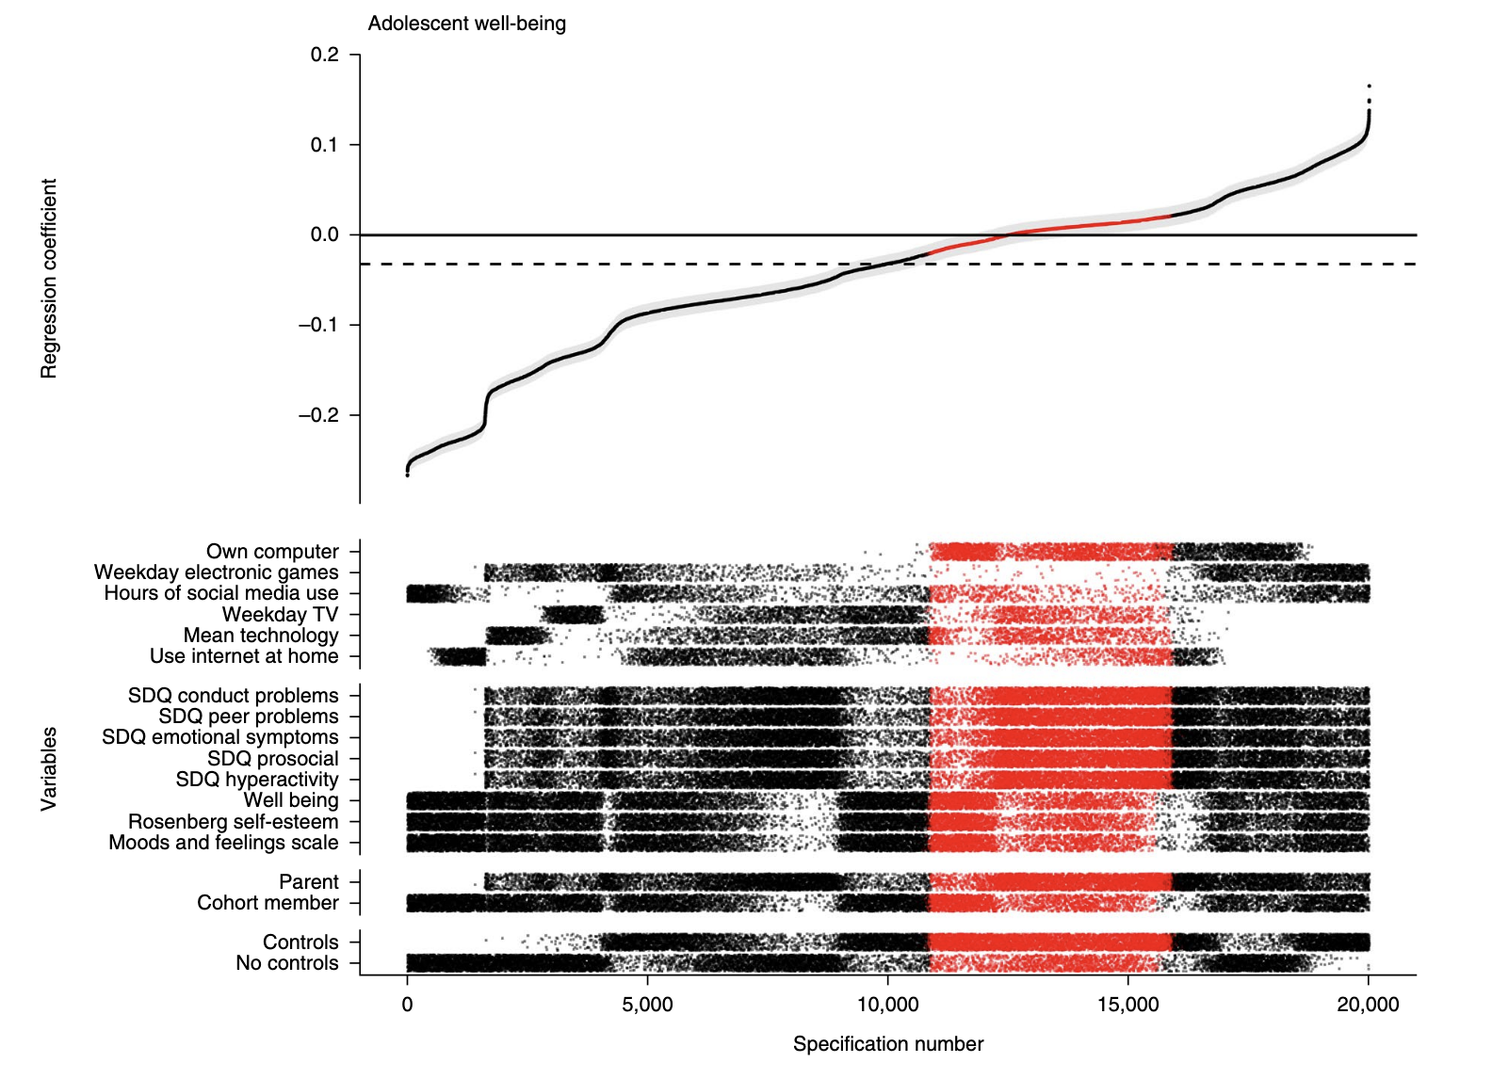
median standardized regression coefficient = -0.005 for the effect of social media use on well-being
Notes:
Looking at another dataset, we see that the same regression coefficients can result in negative or positive effects of social media use on well-being
This representation of data makes it clear that the combination of variables matters in whether
results are significant and/or
effects are strong or weak
Or even in the same direction.
Conclusion of this work: tiny link between social media usage and well-being

Slide 30
What are reproductions good for?
A multiverse of reproductions
I used data in my own research which is now nearly 20 years old.
Many people have analysed it and came to different conclusions
I applied a multiverse approach…
Similar findings as previously: disability & cognitive ability at baseline predict disease progression
Potential for discovery: patient reported outcome measures & vitamin levels
Notes:
Let’s look at another example from the biomedical research
I used data in my own research which is now nearly 20 years old.
Many people have analysed it and came to different conclusions.
The reason is that the dataset was somewhat salami sliced, where many variables were assessed on their own.
This was not done in bad faith but because the dataset contains complex biological information which needed to be processed with expert knowledge.
Nobody knows everything.
Using data as thoroughly as possible is also not uncommon when having patient cohorts
Here we had multiple sclerosis data available sampled over 12 years.
Since it is not clear which of all these previously assessed variables are most useful in predicting whether patients are stable or worsen over time, I used a multiverse approach.
Result: not implausible results, but even some potential for new discovery:
vitamin levels at baseline might be a proxy for immune function
Patient’s self-reports are predictive
This can save money >> instead of complicated assessment, we might just ask people with MS how they do

Slide 31
What are replications good for?
Let’s have a look at the value of replications
Open Science Collaboration (2015): 100 independently performed replications
39% subjectively labelled as successful
Significant effects were ca. ½ the original size
Update from Nosek et a. (2020): adding 207 replications
64% of effects successfully replicated
Effect sizes being 32% smaller than the originals
Notes:
Moving on from reproductions, let’s look at what replications are good for
MAIN POINT RECENTLY: MAP WHAT ACTUALLY REPLICATES
The landmark paper in Science by the open science collaboration provided evidence that things might not be perfect
There might even be a crisis to be addressed as only a fraction of replications were labelled successful
39%
Significant effects were ca. ½ the original size
Update from Nosek et al. (2020): adding 207 replications
64% of effects successfully replicated
Effect sizes being 32% smaller than the originals

Slide 32
What are replications good for?
Let’s have a look at the value of replications
Open Science Collaboration (2015): 100 independently performed replications
39% subjectively labelled as successful (same direction)
Significant effects ≈ 50% of originals
Update from Nosek et al. (2020): adding 207 replications
64% of effects successfully replicated
Effect sizes ≈ 32% smaller than the originals
Carmerer et al. (2018)
61% (13/21) successful
Effect sizes ≈ 50% of originals
Notes:
Similar findings

Slide 33
What are replications good for?
More recent evidence from 176 student replications in the social sciences (Boyce et al., 2023)
successful in 49% of replications
46% had point estimates within the prediction interval
Method proposed in Marthur & Van der Weele (2020), J Roy Stat Soc
R packages for estimation of prediction intervals: Replicate and MetaUtility
Notes:
ore recent evidence from Boyce et al (2023) using data from 10 years student replications
Replication results were judged to be successful in 49% of replications; of the 136 where effect sizes could be numerically compared,
46% had point estimates within the prediction interval of the original outcome (versus the expected 95%).
Why the prediction interval?
Prediction interval is probability that the original study's point estimate would be at least as extreme as it actually was, if in fact the original study were statistically consistent with the replications,
and secondly the estimated proportion of population effects agreeing in direction with the original study.
For closer look at method see Marthur & Van der Weele (2020) >> very nice article explaining and applying the method
There are also R packages, if you are interested

Slide 34
What are replications good for?
More recent evidence from 176 student replications in the social sciences (Boyce et al., 2023)
successful in 49% of replications
46% had point estimates within the prediction interval
What contributed to replication success?
Larger original effects
Within-subjects design
Cognitive psych vs social psych
Using online samples
Notes:
What contributed to replication success?
Larger original effects
Within-subjects design
Cognitive psych vs social psych
Using online samples

Slide 35
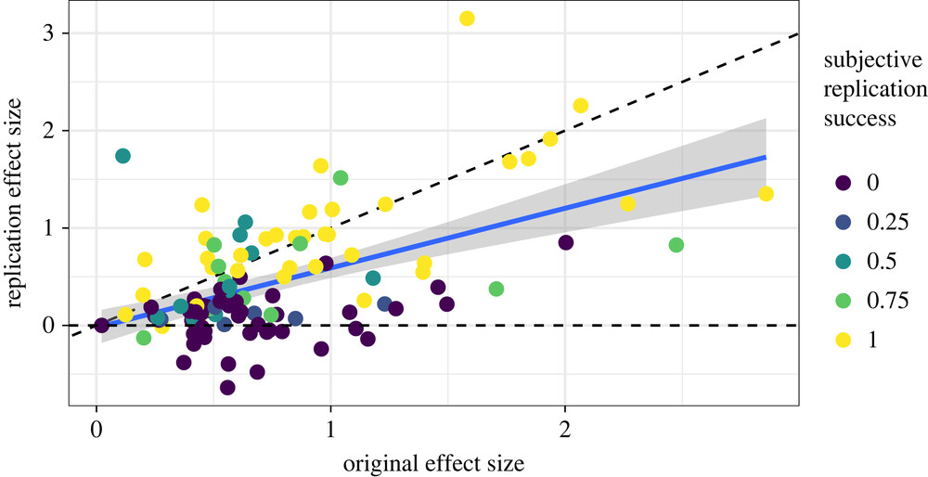
What are replications good for?
More recent evidence from 176 student replications in the social sciences (Boyce et al., 2023)
Notes:
Assocition of the Original effect and replication effect size

Slide 36
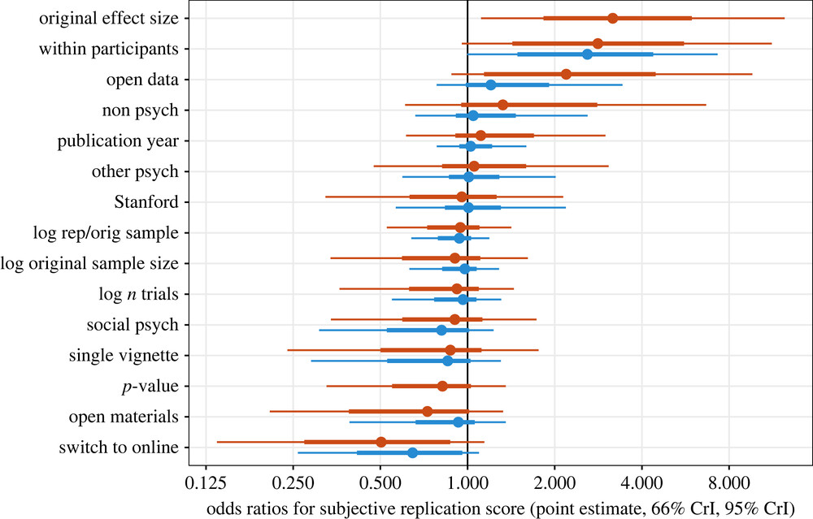
What are replications good for?
Boyce et al., 2023, Royal Soc. Open Sci.
Notes:
Just to briefly showcase, here are the different variables contributing to subjective replication score
Note that there was large uncertainty around the estimates due to the limited sample size of “just” N = 172 replications

Slide 37
What are replications good for?
Registered replication reports vs meta-analyses
Significant difference in effect sizes for 12/15 pairs
Differences are systematic: meta-analytic effects almost 3x larger
Proposed methods to correct meta-analyses cannot mend the bias
Kvarven et al. 2019, Nat Hum Beh
Notes:
We can measure replications against the state-of-the-art in assessing the literature: meta-analyses
Comparing: preregistered replications vs meta-analyses
Significant difference in effect sizes for 12/15 pairs
Differences are systematic: meta-analytic effects almost 3x larger
Proposed methods to correct meta-analyses cannot mend the bias
Replications provide a more sober estimate of the true effects >> preferrable

Slide 38
What are replications good for?
Consequences of the reform movement (including repetitive research) on “Productivity, Creativity, and Progress”:
Vazire (2018), Persp Psych Sci:
“The effects of these changes on creativity are likely to be mixed: Researchers will be less likely to pursue risky questions; more likely to use a broad range of methods, designs, and populations; and less free to define their own best practices and standards of evidence. Finally, the rate of scientific progress-the most important shared goal of scientists-is likely to increase as a result of these changes, although one's subjective experience of making progress will likely become rarer."
Notes:
Let's look at all these replication findings from a bird's perspective
I presented to you many efforts done during the recent years
These influence science and how it is done
That brought up questions and discussions about whether we lose our freedom and creativity as independent thinkers and researchers
Vazire on this
As the focus is more on rigour, the subjective experience might be that less personal progress is made
While at the same time the actual scientific progress should accelerate

Slide 39
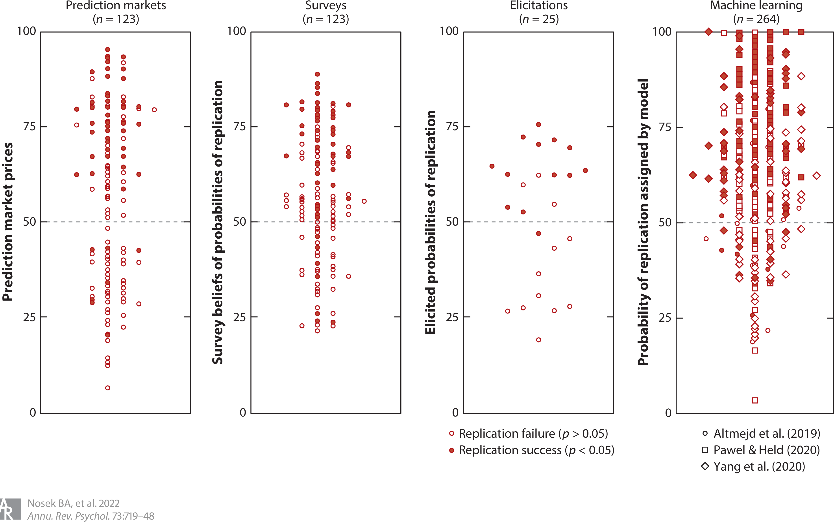
Other ways of assessing replicability
Notes:
Just to be mentioned, there are other ways to assess replicability than doing replications
Goal: Predicting which studies are likely to replicate can save time and resources by focusing efforts on the most important or uncertain findings.
Main Idea: Replication success can be predicted using features from the original study, suggesting credibility can be inferred beforehand.
Here are four methods:
prediction markets
Surveys
elicitations, and
machine learning.
The figure aggregates 123 prediction-replication pairs for which there are both survey and market predictions and outcomes from five different prediction projects (Camerer et al. 2016, 2018; Dreber et al. 2015; Ebersole et al. 2020; Forsell et al. 2019), 25 elicitations for 25 replications (Wintle et al. 2021), and 264 machine learning scores from three projects (Altmejd et al. 2019, Pawel & Held 2020, Yang et al. 2020).
Probabilities of replication were computed on a 0 to 100 scale for all three methods, and all three sets of human predictions were performed by experts.

Slide 40
Other ways of assessing replicability
Notes:
Three human-based prediction methods:
Surveys: People estimate replication success based on study summaries; results are averaged.
Structured elicitation (e.g., IDEA protocol): Small groups give private estimates, discuss, and revise their judgments.
Prediction markets: Participants bet on replication success; market prices reflect predicted probability.
Accuracy of methods:
Prediction markets: 72% accurate (r = 0.52)
Surveys: 64% accurate (r = 0.48)
Structured elicitations: Most accurate (r = 0.75)
Laypeople’s predictions:
59% accurate alone,
67% when given evidence strength info.
Expertise: No clear evidence yet on whether experts are better at predicting replication.
Machine learning models:
Trained on original study features (sample size, p-value, effect size, etc.).
Performed as well as human prediction markets.
Text-based models (using study language) outperformed stats-only models.
Could offer scalable, early replicability assessments if findings replicate.
Alternative statistical forecasting:
Used study info and replication sample sizes.
Performed similar to or worse than prediction markets.
Takeaway: Both human judgment and machine learning can help anticipate replicability, potentially guiding better decision-making in research.

Slide 41
Criticism of repetition
Reinforcing what has been done before
Positivist danger zone
One searches to confirm a hypothesis, in the positivist sense.
Mindless repetitions
Repeating bullshit is not un-bullshitting the bullshit
Waste of resources
Again: mindless repetitions might not make things better
Nobody cares
They are difficult to interpret, hence no value added
Notes:
Let me play devil’s advocate and criticize repetitive research
Reinforcing what has been done there before
Positivist danger zone
One searches to confirm a hypothesis, in the positivist sense.
Mindless repetitions
Repeating bullshit is not un-bullshitting the bullshit
Waste of resources
Again: mindless repetitions might not make things better
Nobody cares
Unfortunately, original research is cited more often
also after unsuccessful replications
Hard to interpret, hence no value added
The ongoing discussion on interpreting repetitive research might be difficult to swallow
If we cannot even put a finger on when a finding is replicated, is the whole enterprise worth the effort?

Slide 42

Rebutting criticism of repetition
Reinforcing what has been done before
Opposite might be true
Either way, repeating ≠redundancy, it is validation
Notes:
Let’s look at some arguments against the criticsm
Just to play the devil’s advocate to the devil’s advocate
Since we are at a repetitive research symposium … ☺
“Reinforcing what has been done before”
Actually, the opposite might be the case:
Repeating prior findings is not redundancy; it is validation.
Assuming that science is cumulative -- Without confirmation and replication, we risk building entire literatures on fragile or false findings.
Repetition is what distinguishes robust knowledge from coincidence, error, or fraud.
A single study rarely tells us the full story—converging evidence is what makes findings trustworthy.

Slide 43
Rebutting criticism of repetition
Reinforcing what has been done before
Positivist danger zone
Repetitive research seem less affected by preconceived notions
Notes:
Positivist danger zone ...
The goal of replication is not blind confirmation, but empirical scrutiny.
Even if the original hypothesis is confirmed, doing so across different methods, samples, and contexts strengthens its credibility.
Moreover, many replications are preregistered or follow rigorous statistical protocols to reduce bias.
This is a safeguard, not a danger zone.
If findings fail to replicate, this leads to scientific self-correction—a fundamental part of progress.

Slide 44
Rebutting criticism of repetition
Reinforcing what has been done before
Positivist danger zone
Mindless repetitions
Repeating can expose studies rather perpetuating them
Often the only way to uncover poorly designed studies
Notes:
Mindless repetitions ...
Replicating flawed studies doesn't perpetuate them—it exposes them.
Repetition is often the only way to uncover poorly designed studies, statistical malpractice, or inflated claims.
It separates signal from noise.
Mindless repetition is indeed unproductive, but purposeful, critical reproduction is the antidote to bullshit, not a contributor to it.

Slide 45
Rebutting criticism of repetition
Reinforcing what has been done before
Positivist danger zone
Mindless repetitions
Waste of resources
More wasteful to base decisions on flawed research
Avoids building empty bubbles or promises
Notes:
Waste of resources ...
It is far more wasteful to base decisions, policies, or further research on unreliable findings.
Reproduction is a form of quality control.
In fields like medicine, psychology, and AI, failing to validate key findings can lead to harm, misdiagnosis, or wasted public funding.
Replication ensures that resources spent on future research, clinical trials, or applications are not built on sand.

Slide 46
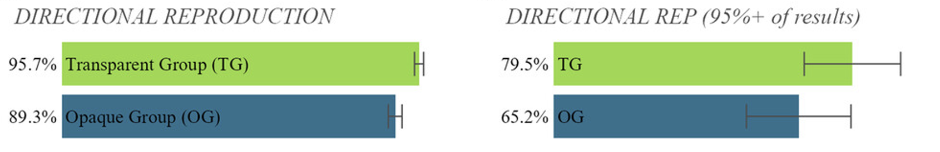
Rebutting criticism of repetition
Reinforcing what has been done before
Positivist danger zone
Mindless repetitions
Waste of resources
They are difficult to interpret, hence no value added
Breznau et al. 2025. Royal Soc. Open Sci
Notes:
While it is true that there is no agreement or standard on how to interpret replication success, this is a poor argument to avoid repetitions
Instead, success can be represented using different standards as e.g., done in Breznau et al paper

Slide 47
Summary repetitive research
Good for …
Outlining different sources of error
Data analysis
Reporting results
Notes:
1. Repetitive research has many advantages and can be used in many different ways
The main advantages are that it can be useful to assess different error source
Thinking of the dead salmon: issues with data analysis
Thinking of my own data, reporting on a selection of variables might influence the results
Thinking of Amy Orban’s multiverse analysis, where selective reporting might have happened

Slide 48
Summary repetitive research
Good for …
Outlining different sources of error
Data analysis
Reporting results
Checking reliability & validity
Are results / effects likely to be true / not true?
Falsify hypotheses → Do we need to update, discard, create new theories?
Notes:
The epistemic reliability
In the different study examples, we can get closer to better quantify uncertainty
This helps among other things to not only assess the value of a theory, whether it needs updating or to be discarded, but ALSO to check real world applications.
This is one of the main motivations of all the large-scale replications I presented
The core questions remains: What is true and what not? Which findings can be trusted and which not?

Slide 49
Summary repetitive research
Good for …
Outlining different sources of error
Data analysis
Reporting results
Checking reliability & validity
Are results / effects likely to be true / not true?
Falsify hypotheses → Do we need to update, discard, create new theories?
Reducing research waste
Entrance point to publication process for early career researchers
Notes:
Reducing research waste
If you don’t know what to do, you can do repetitive research
If you know from the onset that the student or early career scientist’s work is going to go to waste, why not have them do something informative to field, such a replication?
Entrance to publication process for early career scientists

Slide 50
Summary repetitive research
Good for …
Outlining different sources of error
Data analysis
Reporting results
Checking reliability & validity
Are results / effects likely to be true / not true?
Falsify hypotheses → Do we need to update, discard, create new theories?
Reducing research waste
Entrance point to publication process for early career researchers
Not good for …
Pleasing “high-impact” journals (?)
Notes:
2. What it cannot do
Pursuate high impact journal editors (unless done smart or the right way)
LET’S TALK MORE ABOUT THE LAST TWO BITS in the next section

Slide 51
Who is repetitive research good for?
Everybody!?
Funders
Researchers (individuals, teams)
Notes:
I made a point for repetitive research being useful
Funders >> There are some anthroposophic and charity organisations which already apply open science principles and endorse
They want their money to be well spend
Researchers
While it might seem personally threatining when research is being replicated, it is a compliment: the research is so important that it is being replicated
That provides more attention to the research, an opportunity to get to know each other, and to collaborate

Slide 52
Who is repetitive research good for?
Early career researchers (pre-tenure)?
Notes:
How do early career researchers fit into this?
There are some caveats and doing repetitive research is certainly not the most frictionless path towards tenure
I really hope that this changes
I am an ECR myself, so it is not my place to give career advice.
However, just by observing what people cite, use, talk about, I can summarize a little of what I have seen
Namely, there are certainly many things one can do to obtain high-impact repetitive research publications (on whatever metric you want to measure it)
Big team science efforts play a significant role in this, in my opinion
Most of the studies which really shift the field are such studies
On the positive side: one does not need to start such efforts oneself
There are pleanty of teams out there with working structures who are happy to welcome new members
Once you are ready, you can start your own effort
This focus on big team science is what has brought other fields to a completely new level, examples:
CERN
Genetics consortium studies
Neuroimaging consortia, large-scale imaging

Slide 53
Who is repetitive research good for?
Early career researchers (pre-tenure)?
Senior researchers
Notes:
For senior researchers
Build solid foundation for your or the field’s further efforts
Good for science at large
Support the next generation – in 100 years, nobody will care about some article reaching som metric in 2025

Slide 54
How to get started?
Define the goal
Is repetitive research what is needed?
Replication or reproduction?
Ask experience replicators / reproducers & work in a team
Notes:
Before getting started, you need to define your goal
Do you want to bring previous dissertation projects to publication?
Or a new project?
You will also need to ask yourself whether repetitive research is the right tool to answer your question
Perhaps a completely new study will better aid your drug discovery or behavioural intervention exploration
You can then decide what sort of approach and analysis are appropriated
Is a replication necessary or is there data which can be pooled, analyses reproduced?
If you want to replicate, how? Close replication?
Then, you might want to check available resource, perhaps contact the original study authors
It can also be useful to include extensions of the original study
Generally, experienced replicators can help!
This is a long and straining process. Be prepared!
Not all studies are equally easily or difficult replicated
Team work generally helps
Disclaimer: The smartest way is to plan first and talk about things BEFORE starting

Slide 55
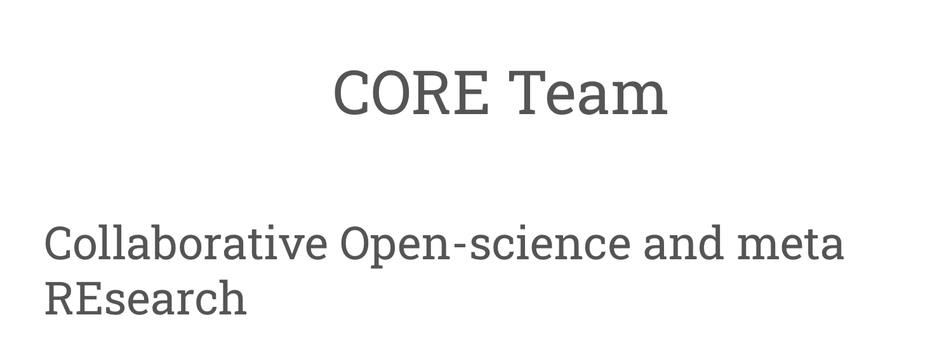
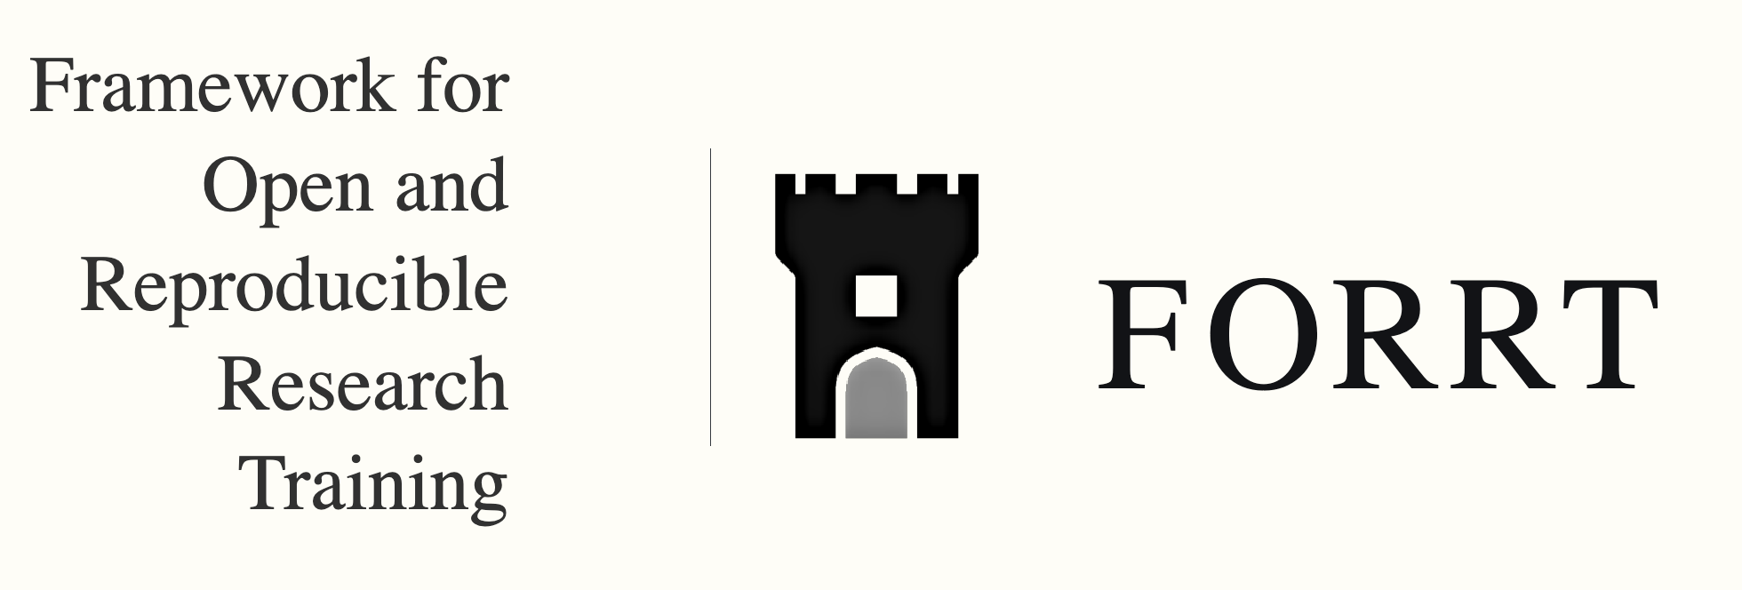

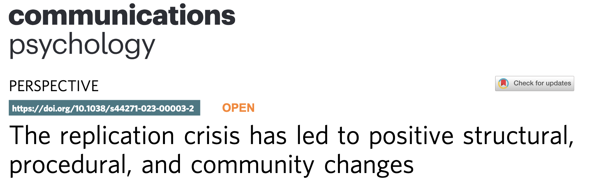
Resources (suggestions)
Gilad Feldman team:
https://mgto.org/core-team/
https://forrt.org/
https://norrn.no/
Korbmacher et al. (2023) Nat Comm Psych
Notes:
If you want to learn more about repetitive research and how to do it, there are many resources
The displayed networks (reproducibility networks including NORRN, as well as CORE, and FORRT) are also happy to collaborate and include you!

Slide 56





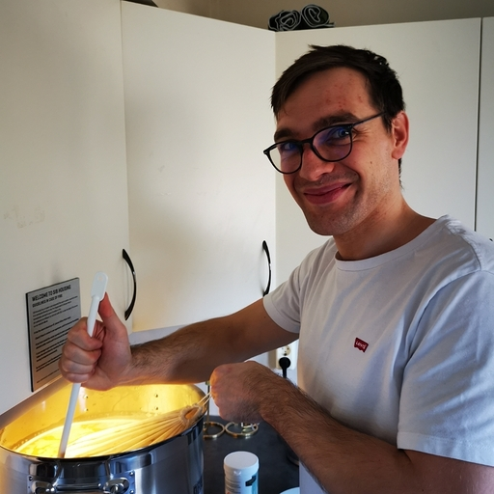
Thank you!
How to contact me:
Email: Max.Korbmacher@gmail.com
Bluesky: @maxkorbmacher.bsky.social
Facebook
Or talk to me when you see me
☺
Thank you to open science collaborators & supporters:
FORRT & especially Flavio Azevedo
Ivan Maximov, Gilad Feldman, Thomas Rhys Evans, Charlotte Pennington, Tamara Kalandaze
And many more
Conversation opener: brewing beer

